Slide 1
WAVE POWER
Notes:
Can any one say how waves are produced?

Slide 2
Introduction
Waves are created by the gravitational action of sun and the moon and also by the interaction of wind with the surface of the sea.
Wave power is practically inexhaustible and classified as a renewable energy source.
Wave energy can be extracted and converted into electricity by wave power machines. They can be deployed either on the shoreline or in deeper waters offshore.

Slide 3
Introduction
Wave energy fluxes in open sea or against coasts may vary from a few watts to kilowatts per meter. In favorable locations, wave energy density can average 65 megawatts per mile of coastline.
The total power of waves breaking on the world's coastlines is estimated at 2 to 3 million megawatts.
They are smallest in summer and greatest in winter.(Westerlies and the Trade winds.)
Wave motion consists of both vertical and horizontal movement of water.
Individual particles of water undergo almost a circular motion, moving up as the crest approaches, forward at the crest, down as it recedes, and backward in the trough.

Slide 4
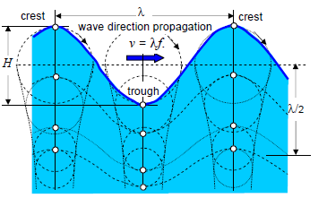
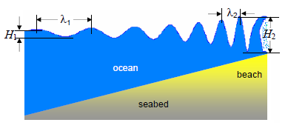
The distance between two consecutive crests, or two consecutive troughs, defines the wavelength λ

Slide 5
How it works
There are several methods of getting energy from waves.
One of them works like a swimming pool wave machine in reverse.
At a swimming pool, air is blown in and out of a chamber beside the pool, which makes the water outside bob up and down, causing waves.

Slide 6
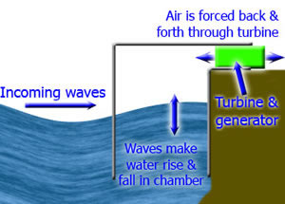

Slide 7
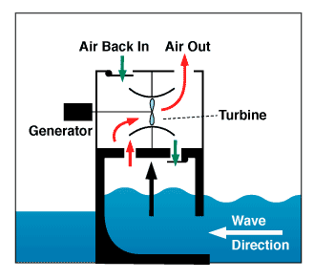
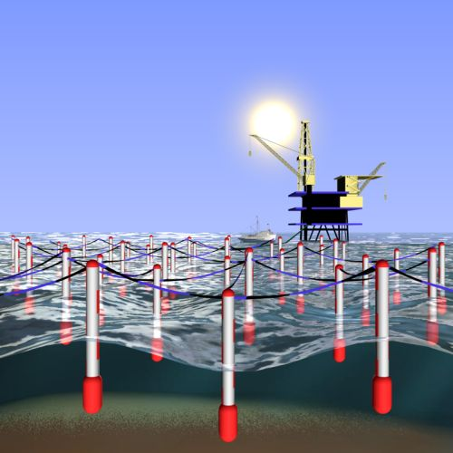

Slide 8
La Rance tidal power plant at St. Malo, France.

Slide 9
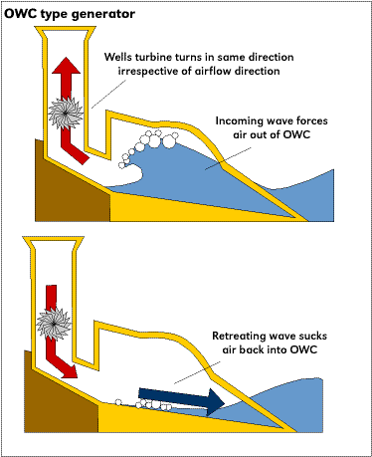
Wave Energy

Slide 10
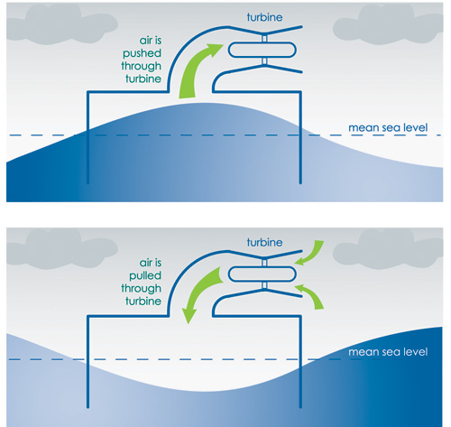
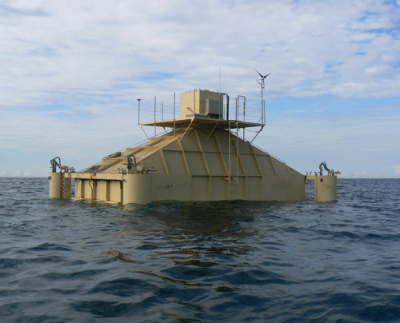
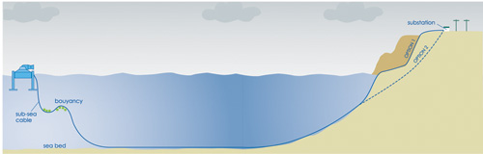
Wave Energy
Oceanlinx

Slide 11
At a wave power station, the waves arriving cause the water in the chamber to rise and fall, which means that air is forced in and out of the hole in the top of the chamber.
We place a turbine in this hole, which is turned by the air rushing in and out.
The turbine turns a generator.

Slide 12
A problem with this design is that the rushing air can be very noisy, unless a silencer is fitted to the turbine.
The noise is not a huge problem anyway, as the waves make quite a bit of noise themselves.

Slide 13
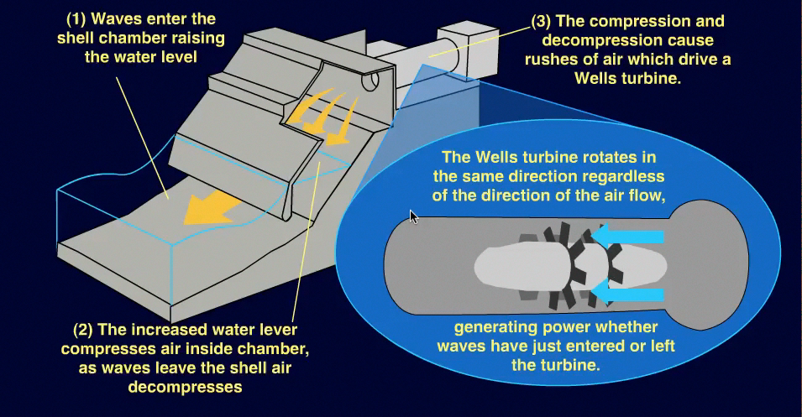
Notes:
A company called Wavegen operate a commercial wave power station called "Limpet" on the Scottish island of Islay.

Slide 14
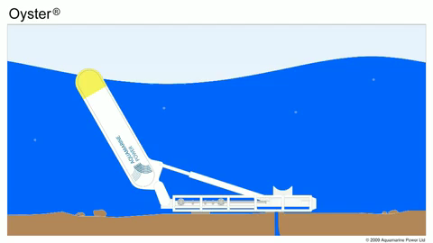
Notes:
The Oyster wave energy device

Slide 15
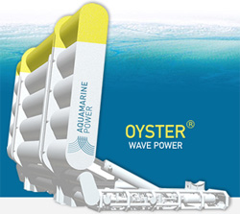
Notes:
The action of the waves moves the device, pumping hydraulic fluid to a shore station to drive a generator.

Slide 16
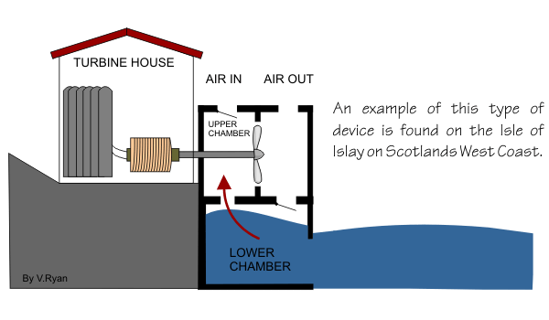

Slide 17
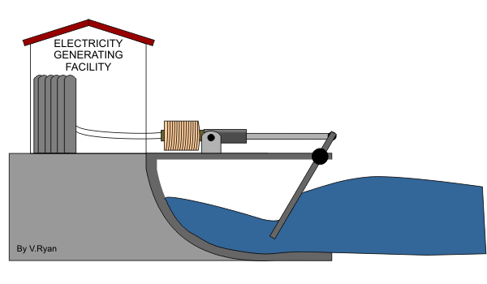

Slide 18
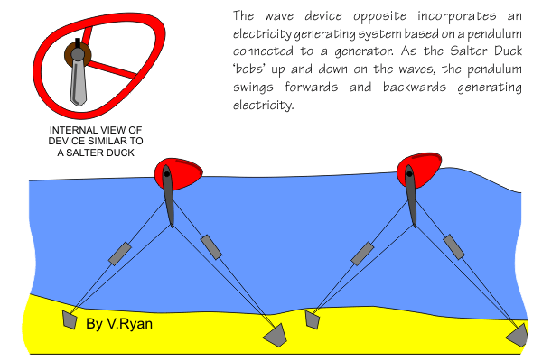

Slide 19
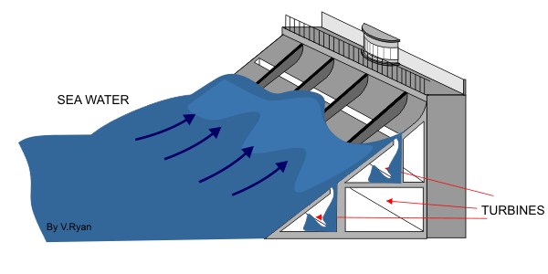

Slide 20
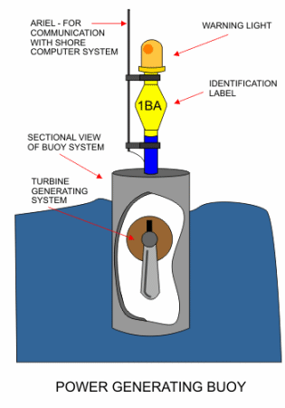

Slide 21
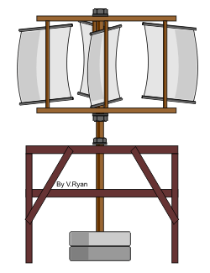

Slide 22
Advantages
The energy is free - no fuel needed, no waste produced.
Not expensive to operate and maintain.
Can produce a great deal of energy.

Slide 23
Disadvantages
Depends on the waves - sometimes you'll get loads of energy, sometimes almost nothing.
Needs a suitable site, where waves are consistently strong.
Some designs are noisy. But then again, so are waves, so any noise is unlikely to be a problem.
Must be able to withstand very rough weather.

Slide 24


